Slide 1
SDLC Life Cycle Models

Slide 2
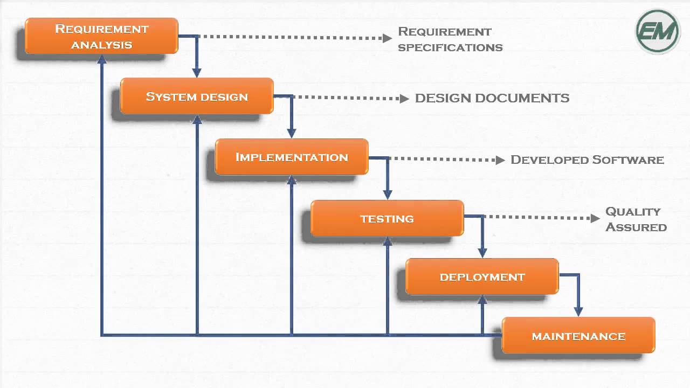
Waterfall Model

Slide 3
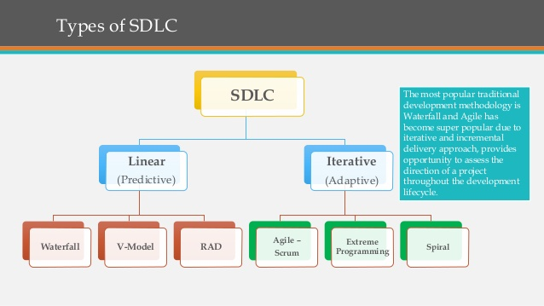
Ref : https://www.techuz.com/blog/top-12-sdlc-methodologies-with-pros-and-cons/ https://melsatar.blog/2012/03/15/software-development-life-cycle-models-and-methodologies/

Slide 4
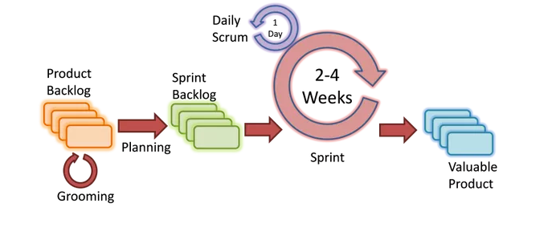
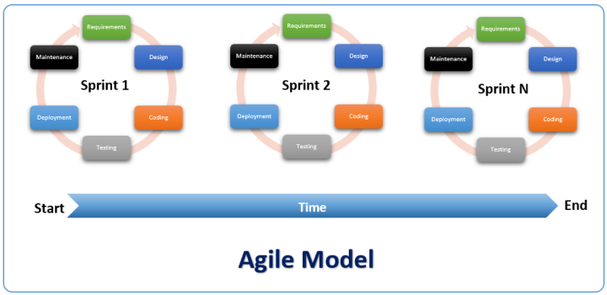

Slide 5
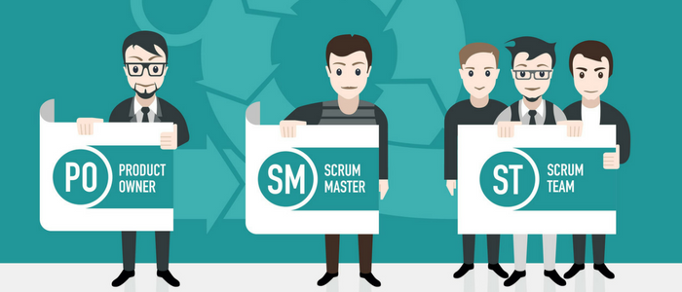

Slide 6
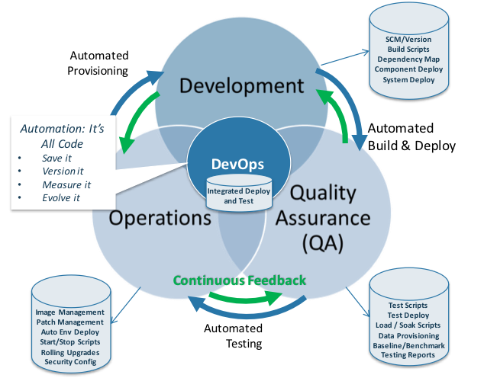

Slide 7
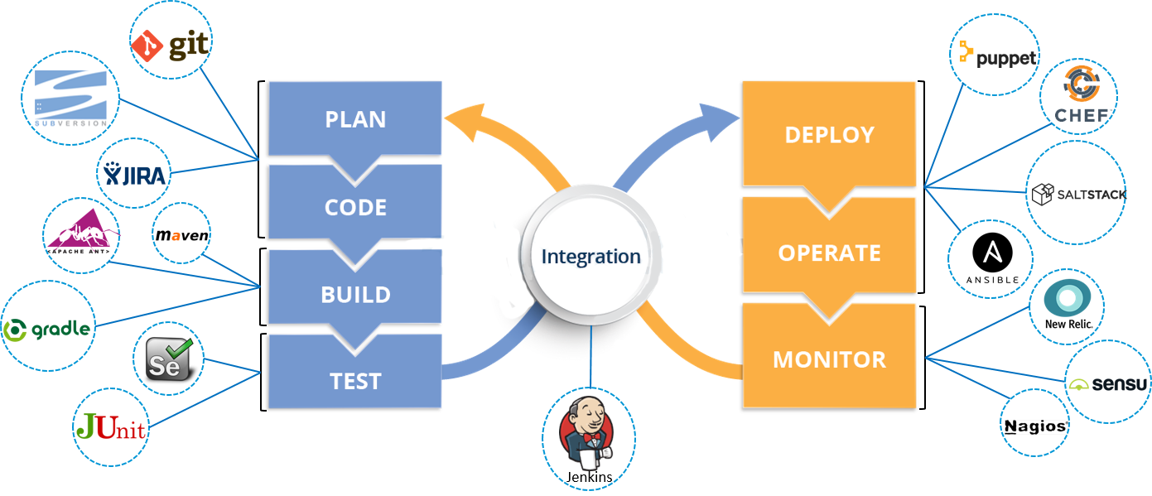

Slide 8
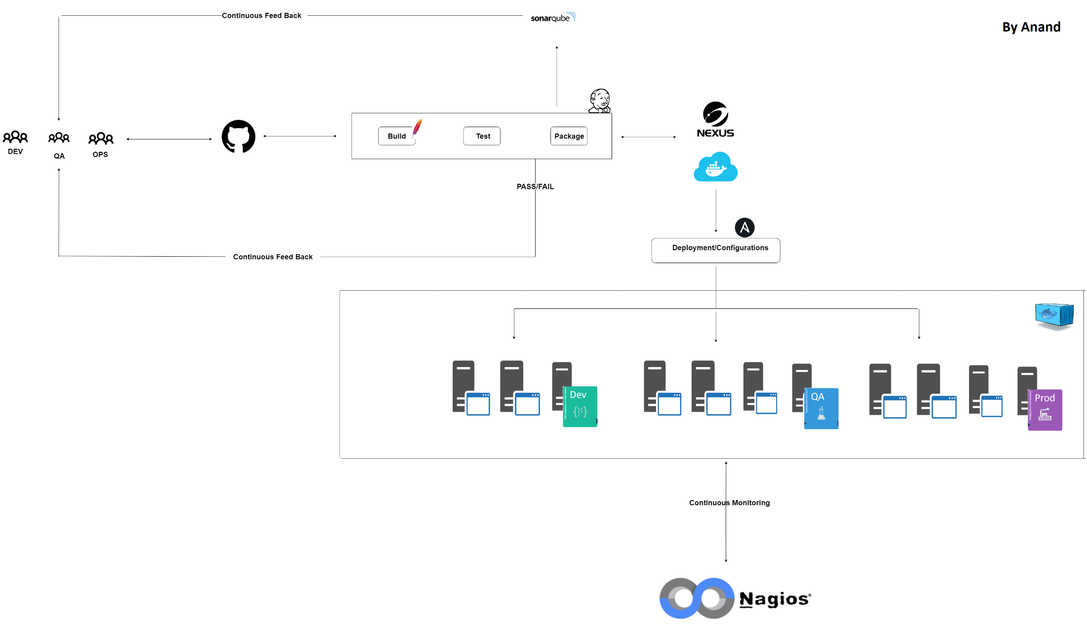

Slide 9
Tools we are going to cover: - Git/GitHub - Maven/NPM - TomCat - Jenkins - Ansible - Docker - Kubernetes - Nexus - SonarQube - Apache/Nginx - Nagios/Grafana/Monit - AWS ( EC2,VPC,RDS)

Slide 10
Thank you

